Slide 1
Cuba

Slide 2
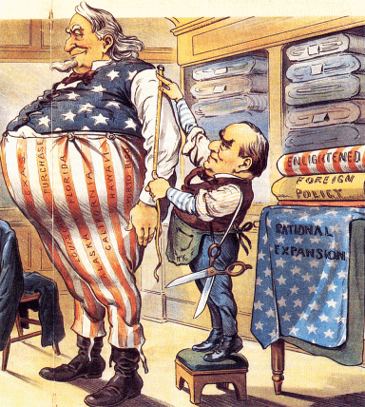
The Imperialist Tailor

Slide 3
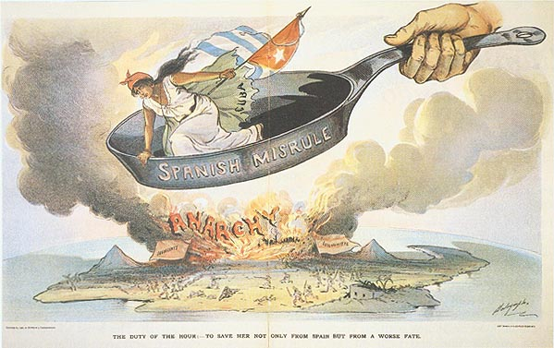
Spanish Misrule in Cuba
Cubans had been resisting Spanish rule since 1868
In 1895, Cubans thrown into open rebellion
Cubans deliberately devastated the island to force Spaniards to leave
Spanish, commanded by General Weyler, confined civilians to concentration camps with thousands of Cubans victims of malnutrition and disease

Slide 4
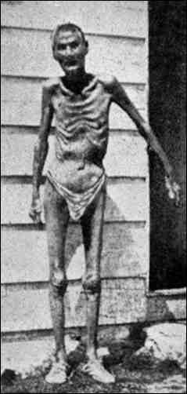
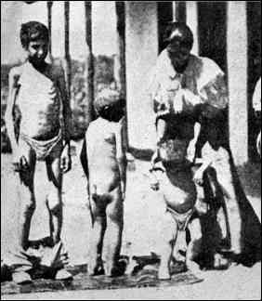
Valeriano Weyler’s “Reconcentration” Policy

Slide 5
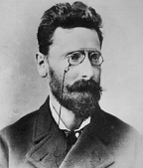
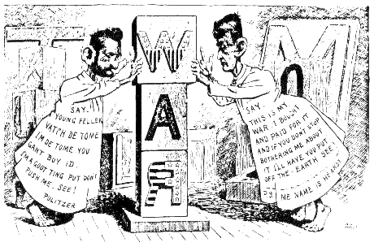
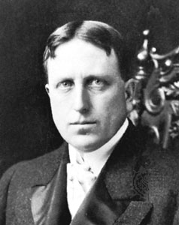
“Yellow Journalism” & Jingoism
Joseph Pulitzer (The World)
Hearst to Frederick Remington: You furnish the pictures, and I’ll furnish the war!
Jingoism-intense burst of national pride and desire for an aggressive foreign policy
William Randolph Hearst (The Journal)

Slide 6
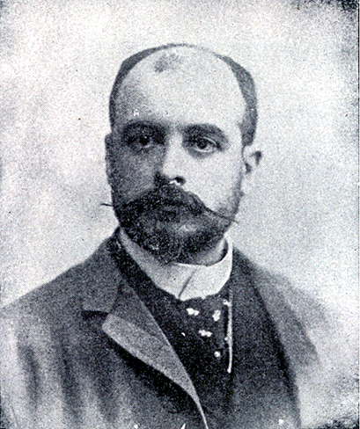
De Lôme Letter
Dupuy de Lôme, Spanish Ambassador to the U.S.
Criticized President McKinley as weak and a bidder for the admiration of the crowd, besides being a would-be politician who tries to leave a door open behind himself while keeping on good terms with the jingoes of his party.

Slide 7
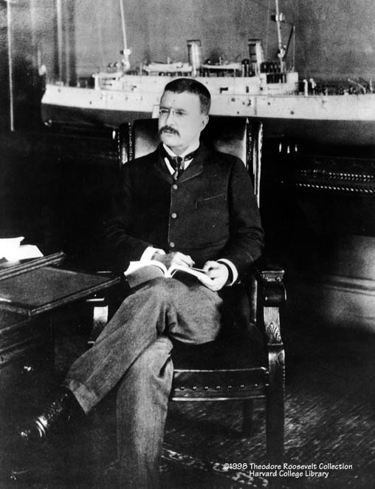
Theodore Roosevelt
Assistant Secretary of the Navy in the McKinley administration.
Imperialist and American nationalist.
Criticized President McKinley as having the backbone of a chocolate éclair!
Resigns his position to fight in Cuba.

Slide 8
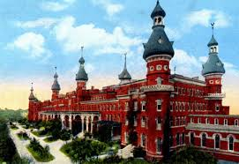
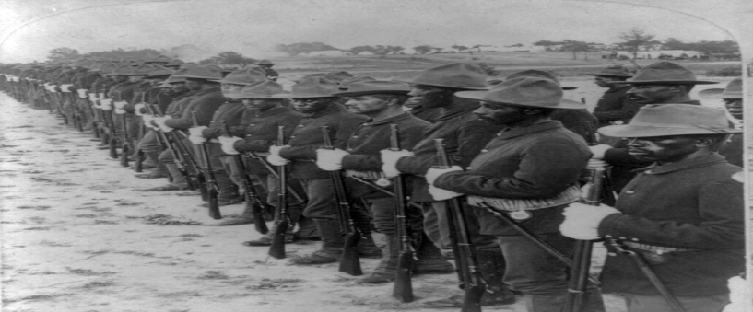
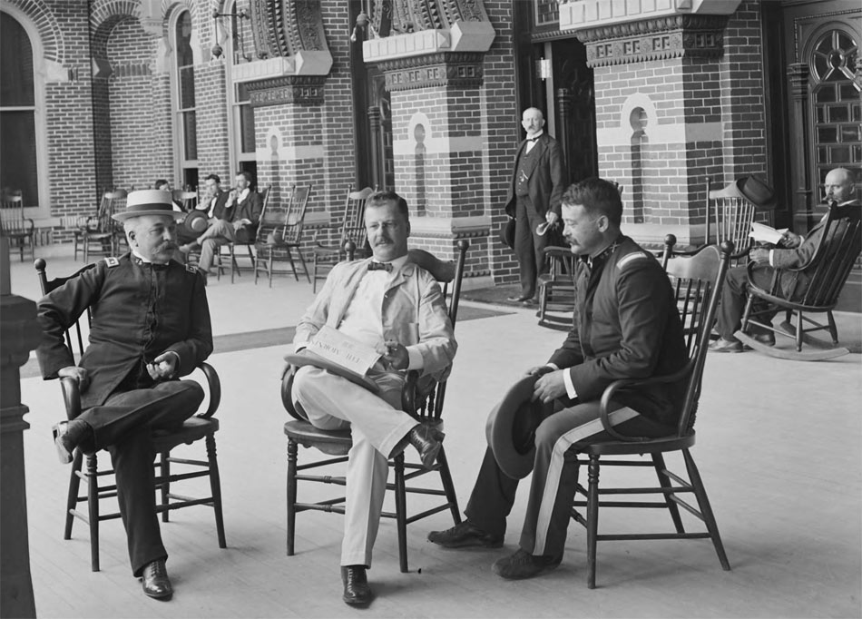
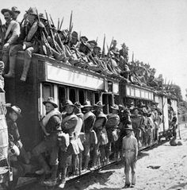
US Army Staging at Tampa Bay

Slide 9
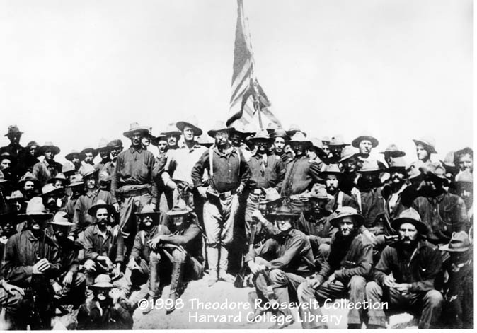
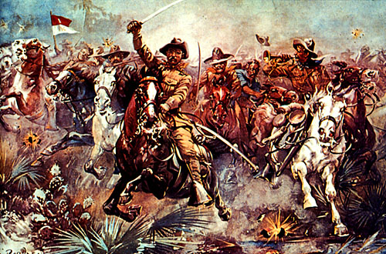
The “Rough Riders”
Elite cavalry unit lead by Theodore Roosevelt who resigned as Assistant Secretary of the Navy
Made up mostly of NE social aristocrats and frontier cowboys and Indians (All could ride and shoot)
Famous for their charge up Kettle Hill during the Battle of San Juan Hill in the face of heavy Spanish fire

Slide 10
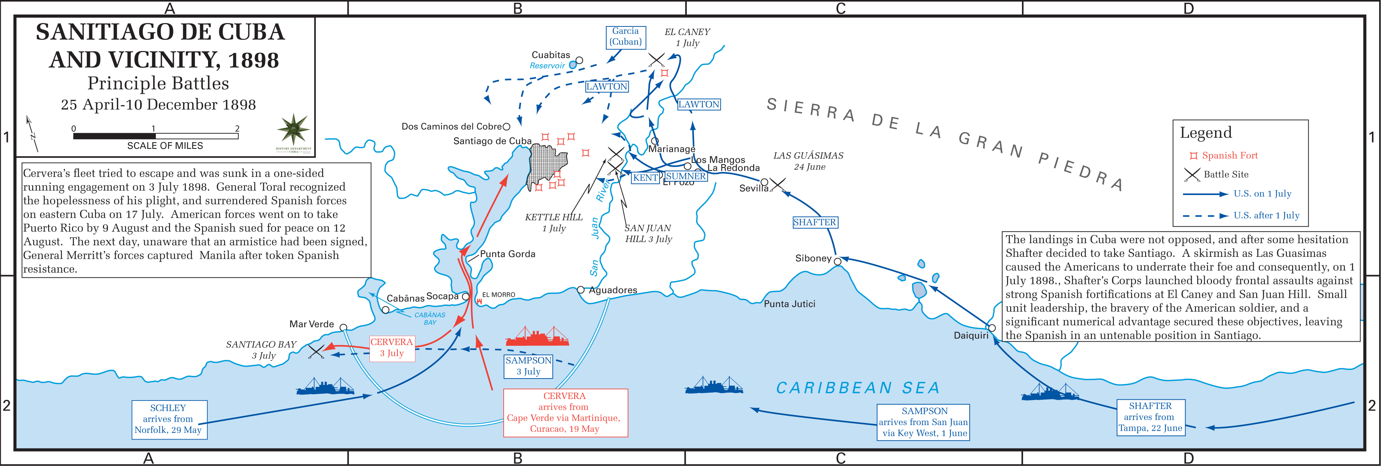
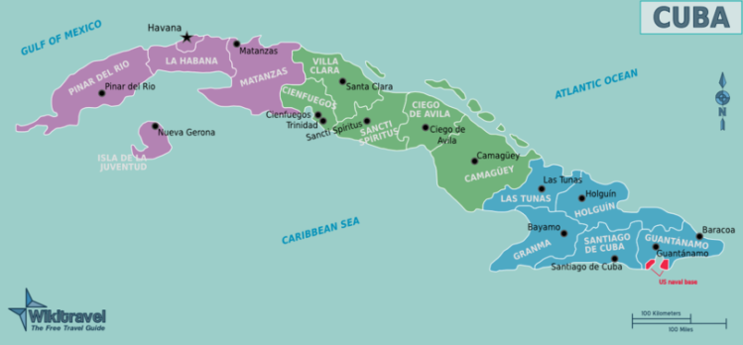

Slide 11
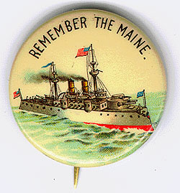
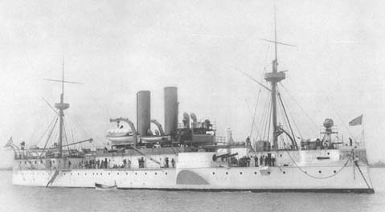
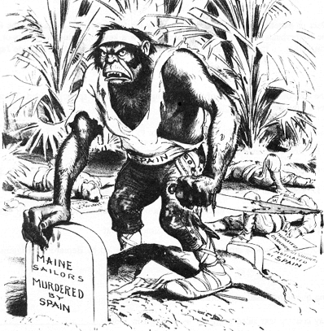
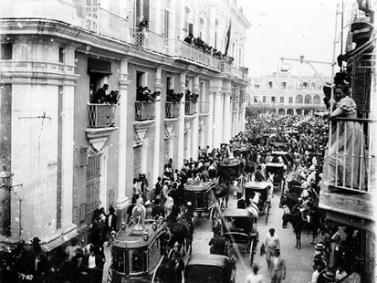
Remember the Maine and to Hell with Spain!
Funeral for Maine victims in Havana

Slide 12
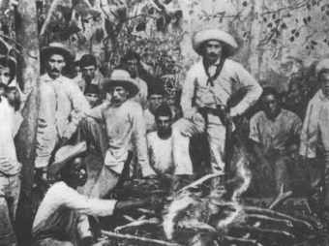
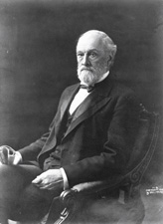
Cuban Independence?
Teller Amendment (1898)- US would not annex Cuba
Platt Amendment (1903)
Cuba was not to enter into any agreements with foreign powers that would endanger its independence.
The U.S. could intervene in Cuban affairs if necessary to maintain an efficient, independent govt.
Cuba must lease Guantanamo Bay to the U.S. for naval and coaling station.
Cuba must not build up an excessive public debt.
Senator Orville Platt

Slide 13
The Spanish-American War (1898): “That Splendid Little War”
Take notes in your notebook on the following video by PBS “Crucible of Empire”
Write down and answer the following questions:
What was the reaction when McKinley called for troops?
Why were regiments of black soldiers called for and how were they treated?
Who were the Rough Riders?
How was the US Army ill prepared for war in Cuba?
How did newspapers cover the war?
Explain the Battle of San Juan Hill.
Why did Theodore Roosevelt get all the credit for San Juan Hill?
What happened to the Spanish Armada at the Battle of Santiago?
How did disease effect US troops?

Slide 14
10. Why were the Cubans upset about the surrender of Santiago and surrender of the Spanish in Cuba?
11. How did the US and Filipino rebels work together when seizing Manila?
12. What was the Americans view of Filipino rebels?
13. What happened during the battle of Manila and how did it leave out Filipino Rebels? What did Aguinaldo do in response?
Act Three
14. What four areas did the US receive from Spain in the Treaty of Paris?
15 Explain the debate for and against the annexation of the Philippines.
16. One anti-imperialist was quoted as saying, “Dewey took Manila with the loss of one man and all our institutions” What does this quote mean?
17. What was the Teller Amendment in Cuba?
18. How and why did the Filipinos use guerilla warfare to fight the US? How did this lead to American brutality in the Philippines?
19. What was the Platt Amendment in Cuba?
20. Explain William Howard Taft’s policy of “benevolent assimilation”.
21. What happened to McKinley in Buffalo?
22. What ultimately happened in the Philippines and Cuba?

Slide 15
The
Philippines

Slide 16
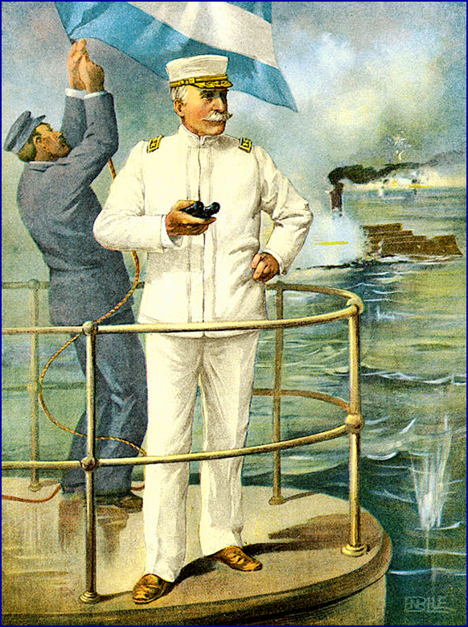
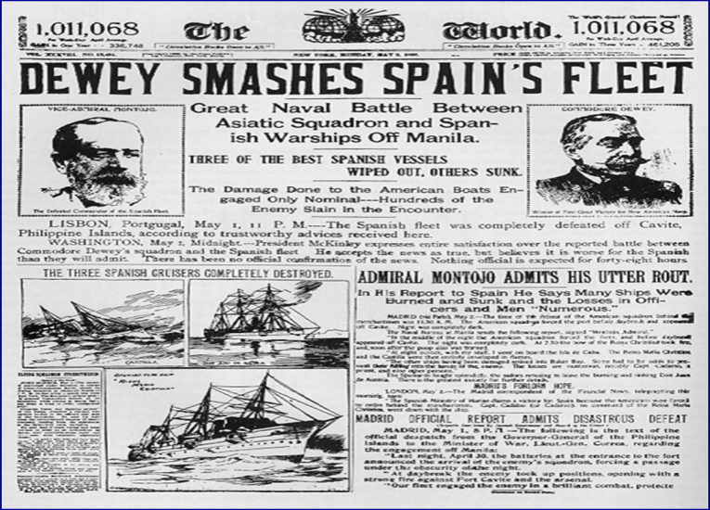
The Spanish-American War (1898): “That Splendid Little War”
Roosevelt strengthened the Navy’s Pacific squadron and instructed its commander Commodore George Dewey
Immediately after war was declared, Dewey sailed for the Philippines
May 1st, 1898 Dewey sailed his squadron into Manila Bay and Completely destroyed the aging Spanish fleet there
When American land forces arrived the Spanish surrendered the city of Manila

Slide 17
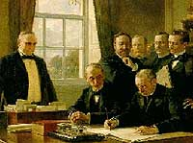
The Treaty of Paris: 1898
Cuba was freed from Spanish rule.
Spain gave up Puerto Rico and the island of Guam.
The U. S. paid Spain $20 mil. for the Philippines.
The U. S. becomes an imperial power!

Slide 18
Debate Over the Philippines
Controlling a large territory thousands of miles away seemed to be a monumental task
McKinley was reluctant to annex the Philippines yet saw no acceptable alternative
He saw the Filipinos as “unfit to self govern” and therefore needed the US
Debate in the Senate was furious about whether to accept the term of the Treaty of Paris with a powerful anti-imperialist movement

Slide 19
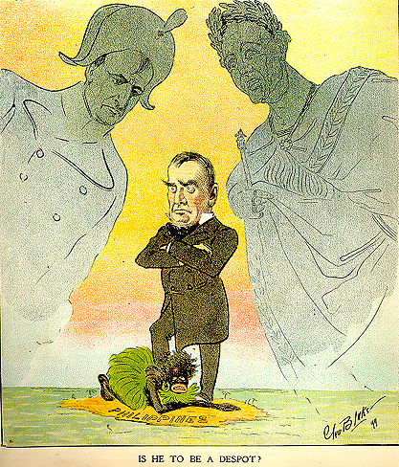
Is He To Be a Despot? The Anti-Imperialists
Anti-Imperialist were some of the nation’s wealthiest and most influential figures
Some believed simply that imperialism was immoral
Others feared the “polluting” of the American population with “inferior” Asian races
Industrial workers feared being undercut by a flood of cheap labor
Conservatives feared large standing armies and foreign alliances would threaten American liberty
Sugar growers and other feared unwelcome competition from the new territories

Slide 20
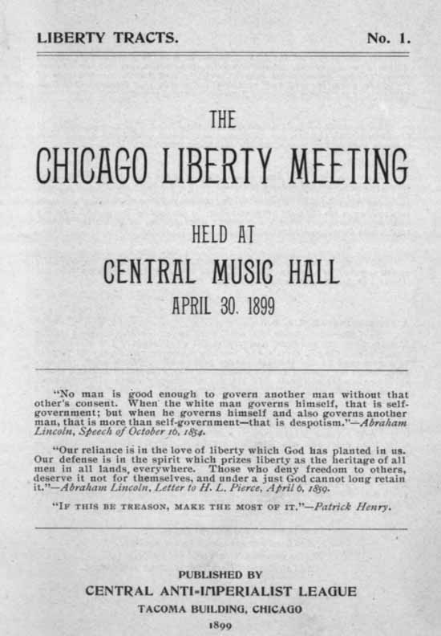
The American Anti-Imperialist League
Founded in 1899.
Mark Twain, Andrew Carnegie, William James, and William Jennings Bryan among the leaders.
Campaigned against the annexation of the Philippines and other acts of imperialism.

Slide 21
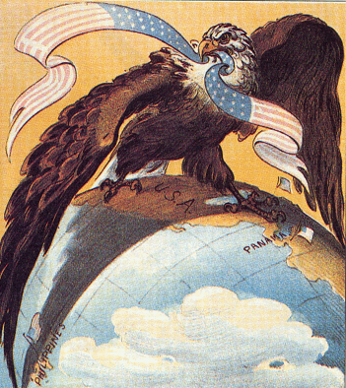
Our “Sphere of Influence”: The Imperialists
Some businessmen believed annexation would position the US to dominate the Asian trade
Republican’s saw advantages for their party in gaining new territories though wars fought and won by a Republican administration
Strongest argument for annexation of the Philippines was that if the US had control then no other nation could cease control

Slide 22
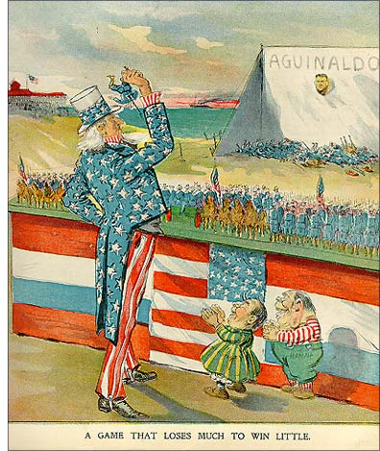
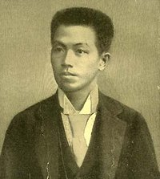
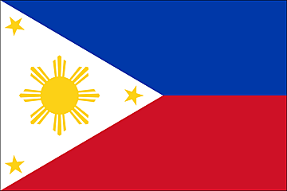
Emilio Aguinaldo
Leader of the Filipino Uprising.
July 4, 1946: Philippine independence

Slide 23
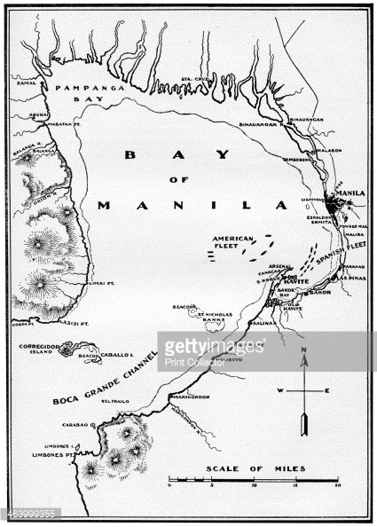

Slide 24
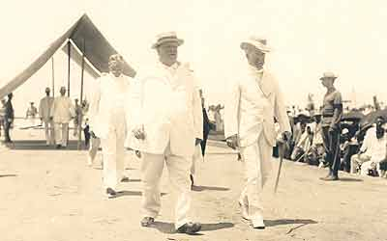
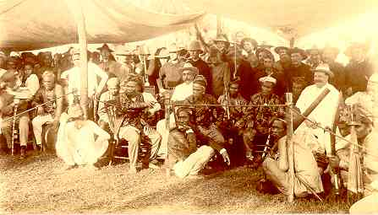
William H. Taft, 1st Gov.-General of the Philippines
Great administrator.

Slide 25
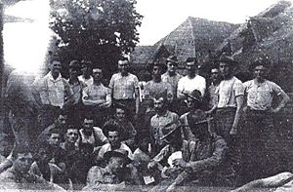
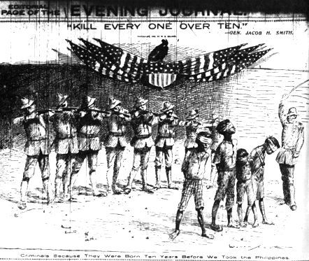
Balangiga massacre
9th Infantry

Slide 26
DILEMMA--Did
U. S. citizenship
follow the flag??

